Slide 1
The Pathway to Healthy Air in the UK
Presented by Imogen Martineau
Clean Air Fund
May 2022

Slide 2
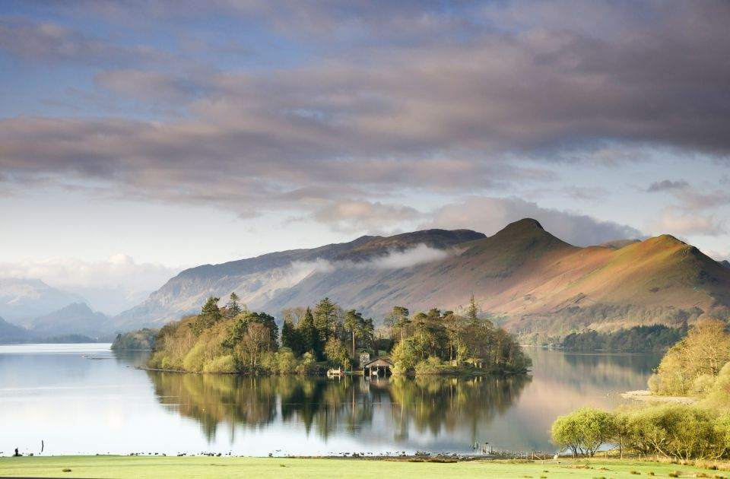

Slide 3
What are the barriers to clean air across the UK?

Slide 4
What are the barriers to clean air across the UK?
Too difficult
Not enough policy solutions
Cost
Lack of public awareness
Lack of political will
Party politics
Vested interests

Slide 5
What are the barriers to clean air in the UK?
Too difficult
Not enough policy solutions
Cost
Lack of public awareness
Lack of political will
Party politics
Vested interests

Slide 6
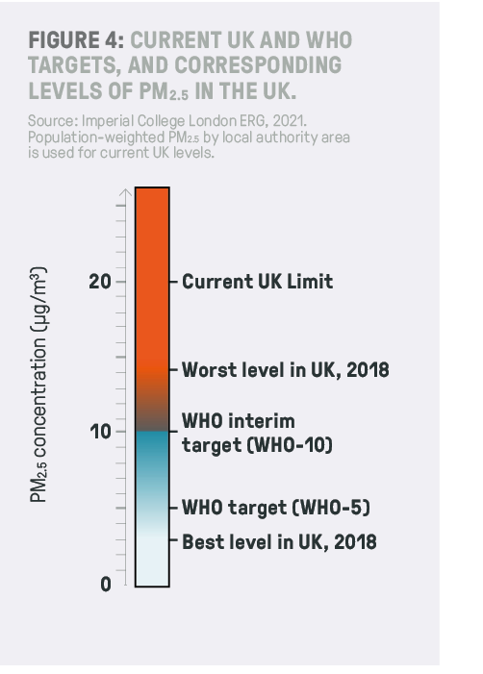
Setting a target for PM2.5 in the UK

Slide 7
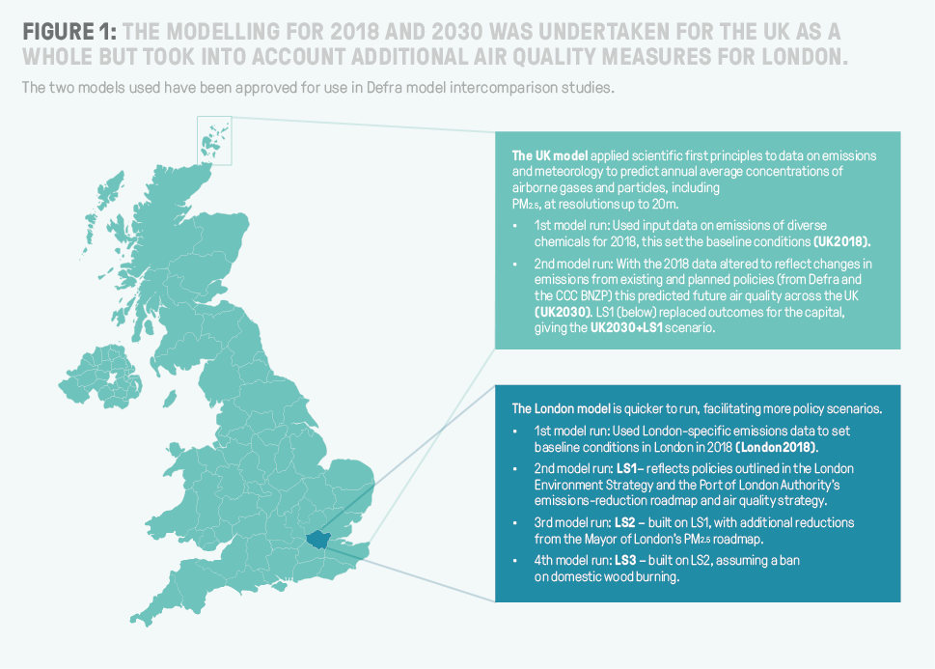

Slide 8
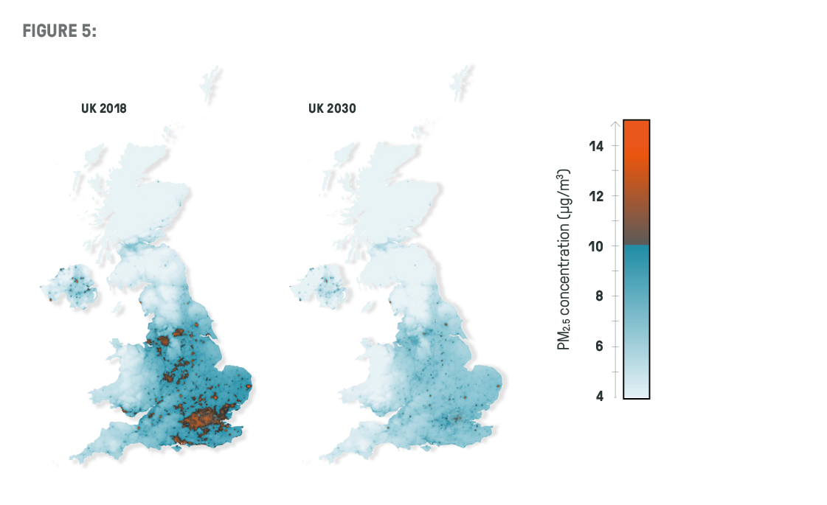
Notes:
.

Slide 9
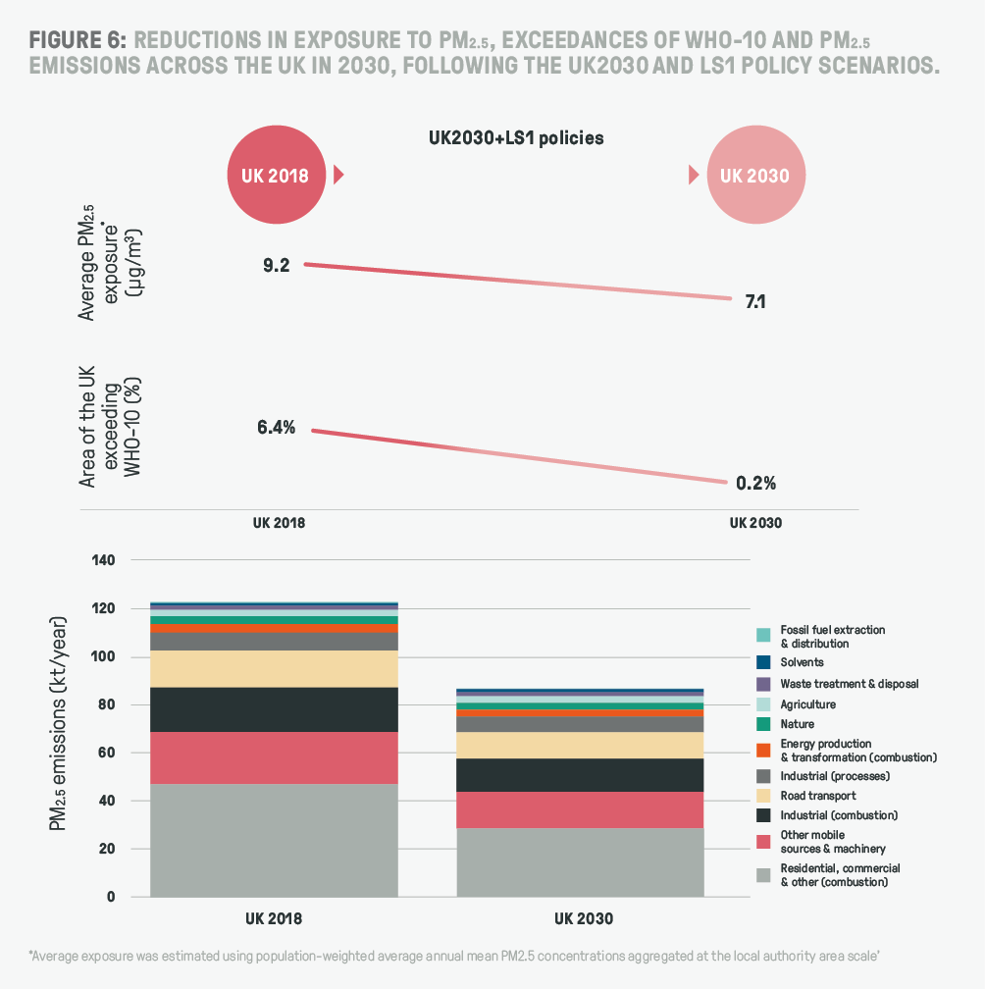

Slide 10
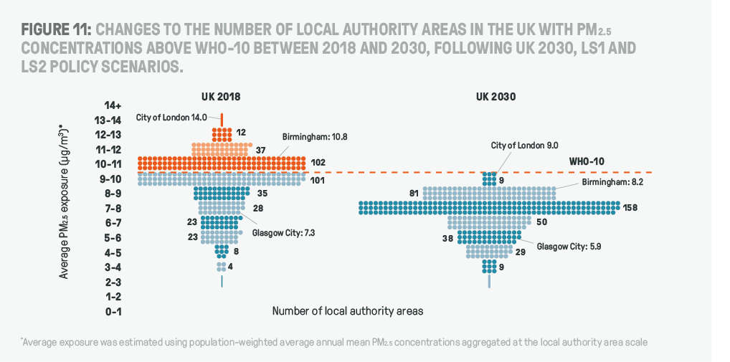

Slide 11
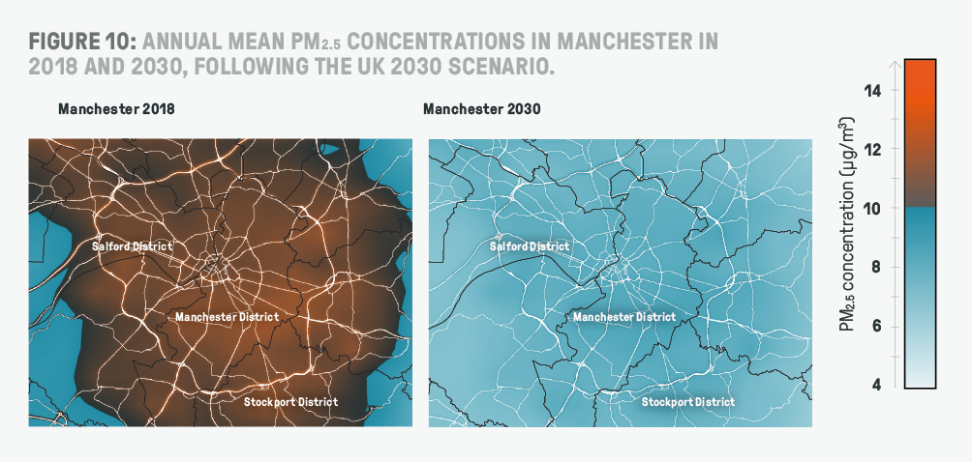

Slide 12
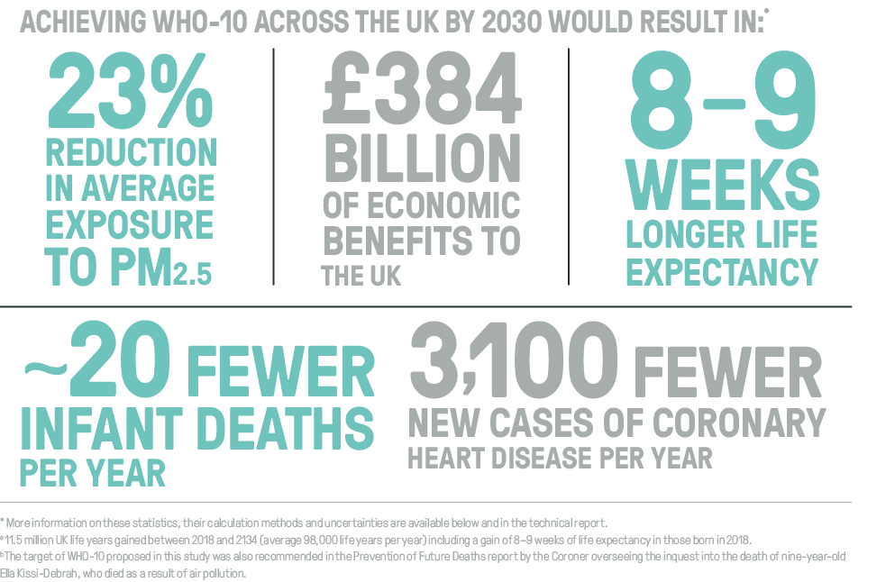

Slide 13
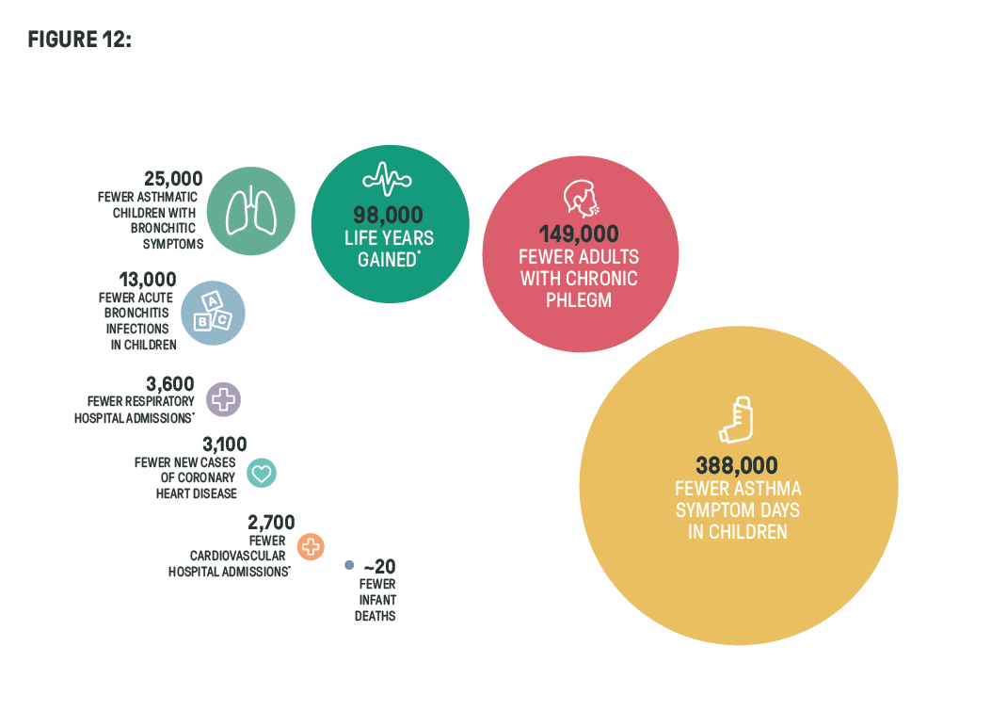

Slide 14
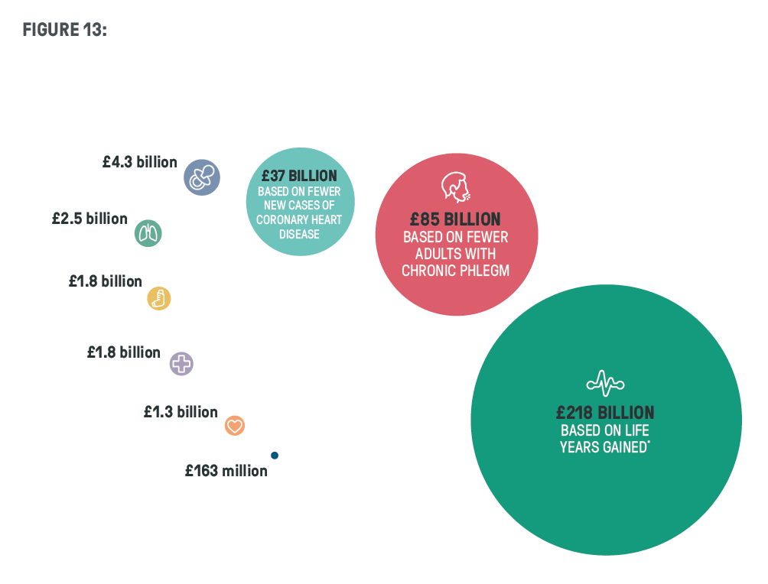

Slide 15
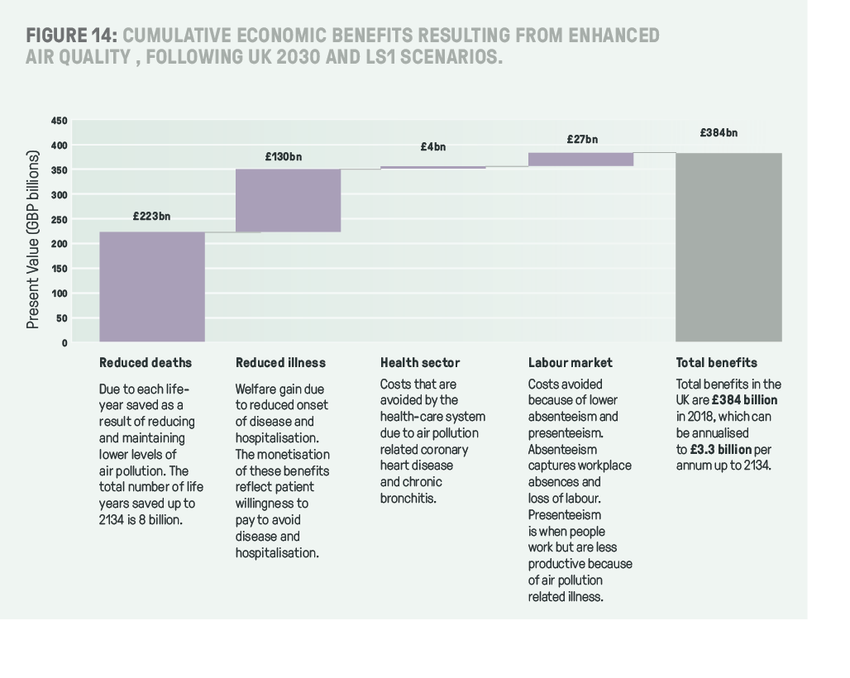

Slide 16
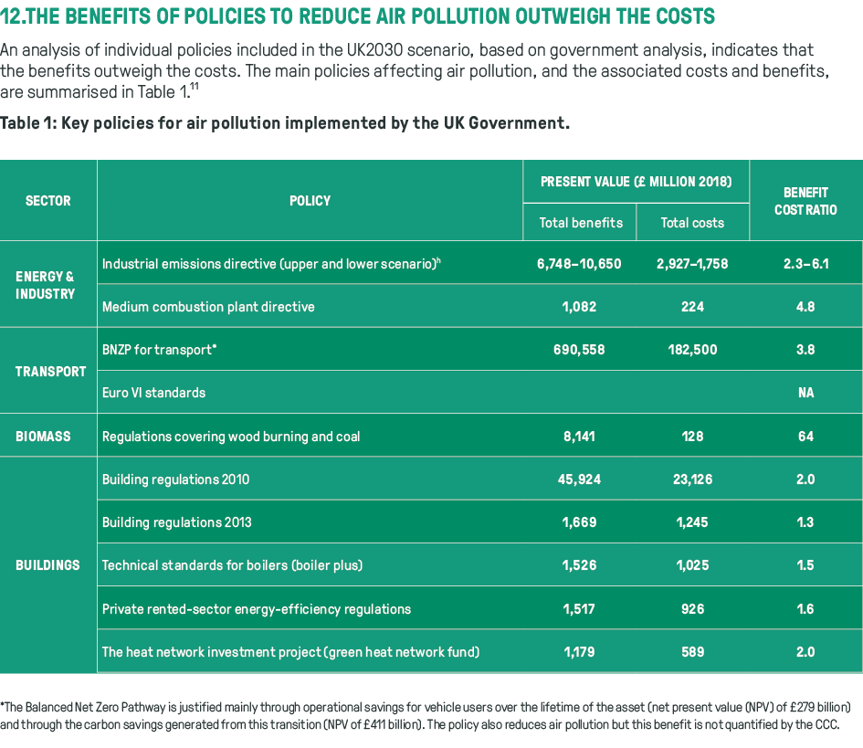

Slide 17
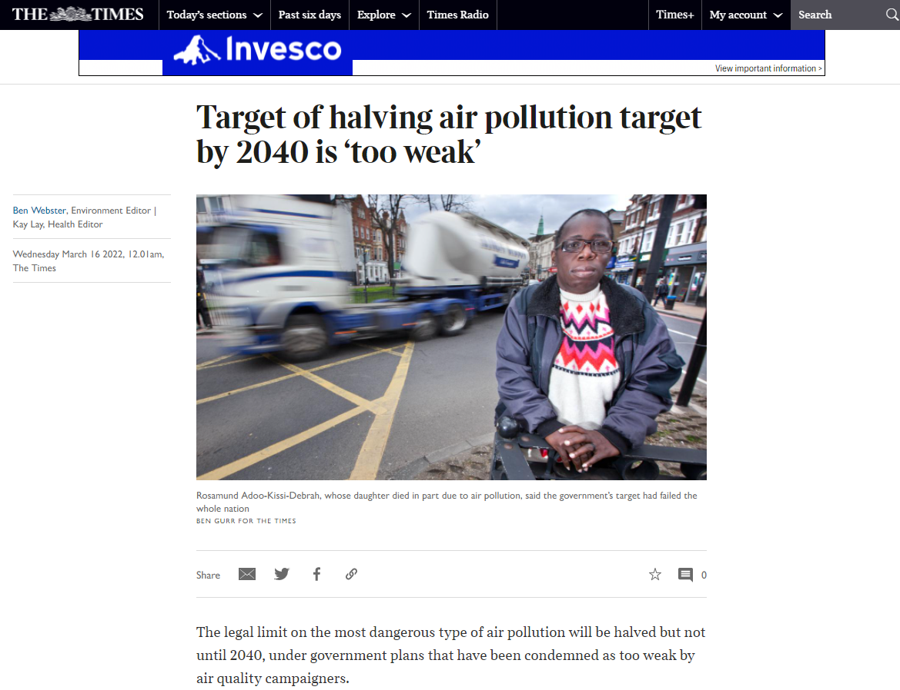
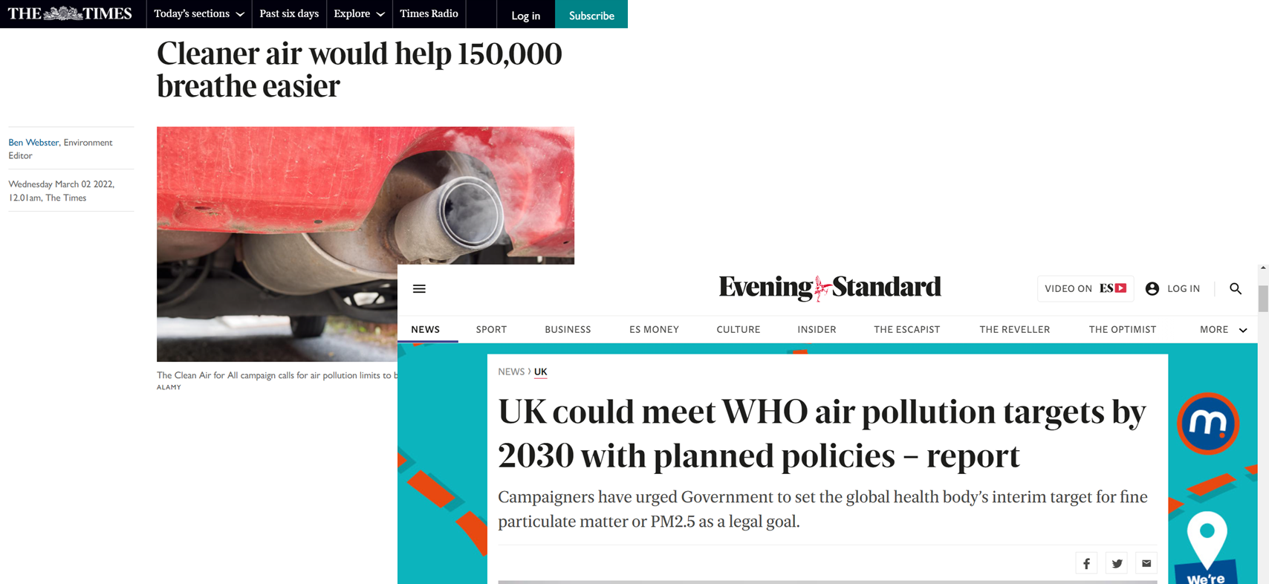
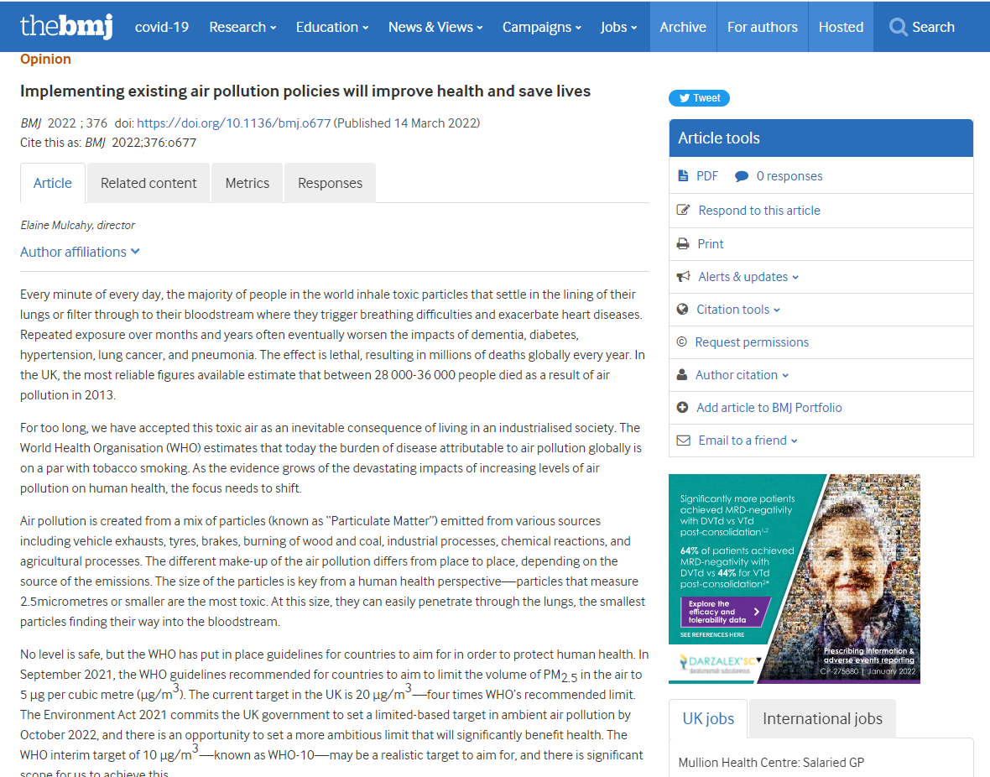

Slide 18
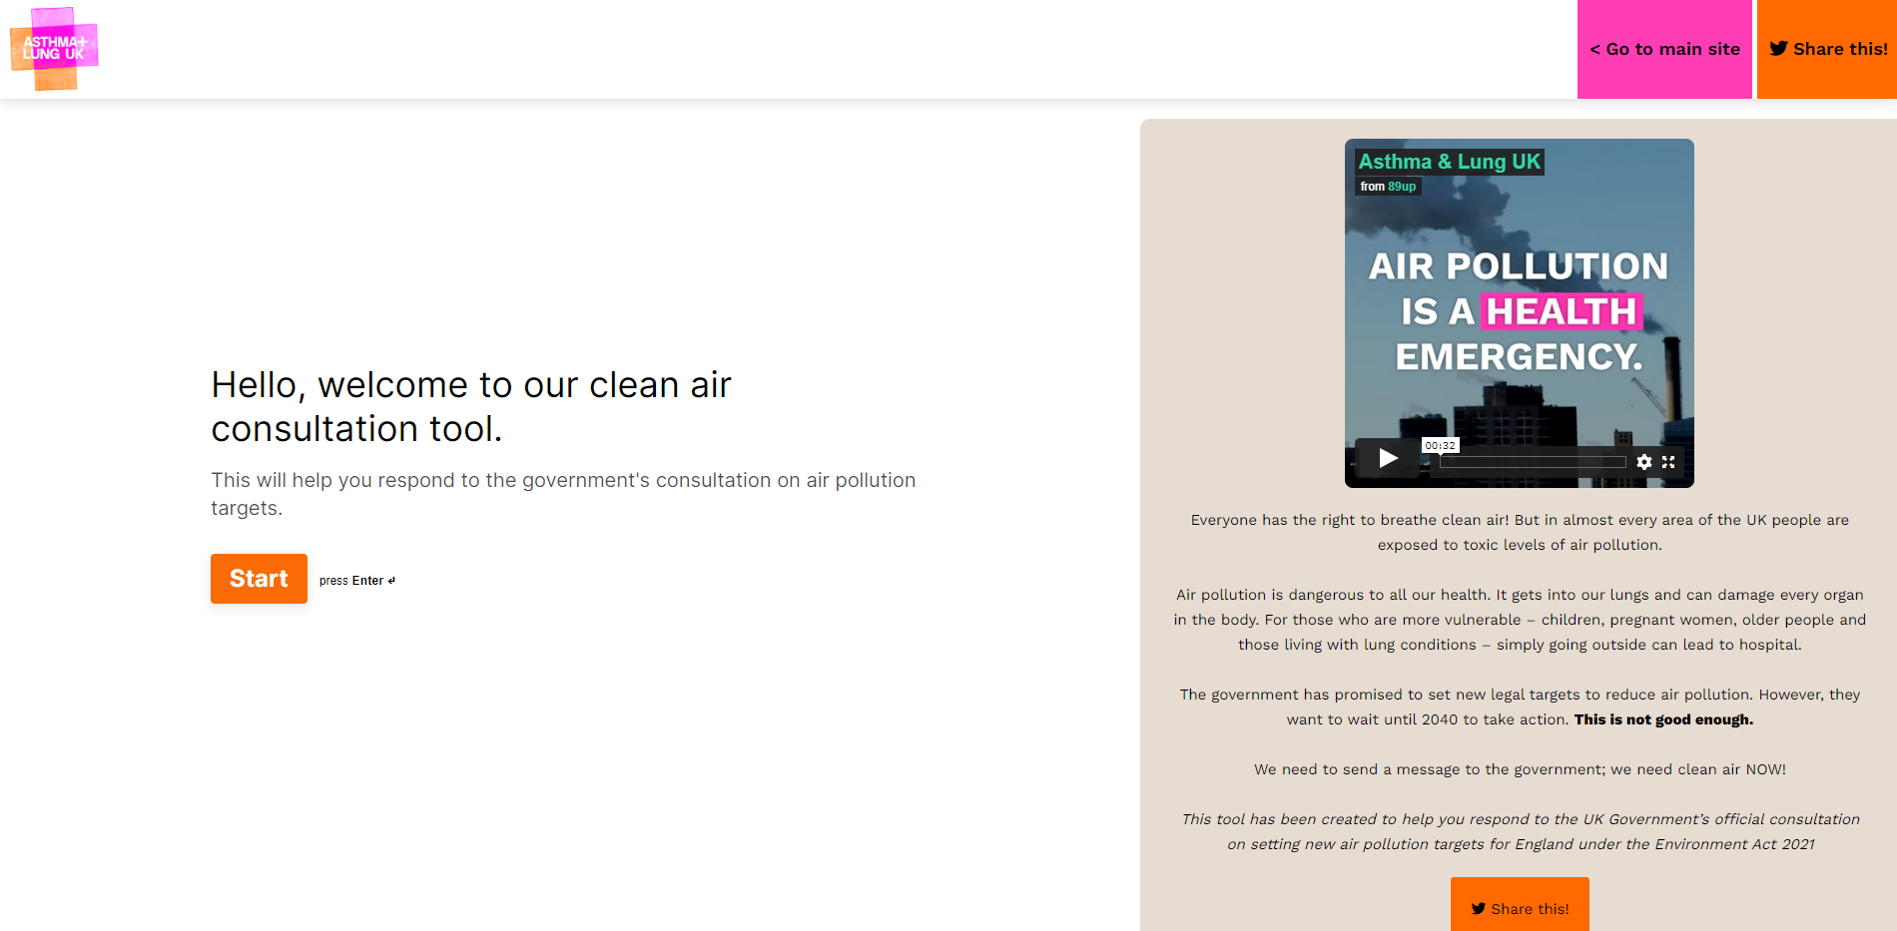

Slide 19
What are the barriers to clean air in the UK?
Too difficult
Not enough policy solutions
Cost
Lack of public awareness
Lack of political will
Party politics
Vested interests

Slide 20
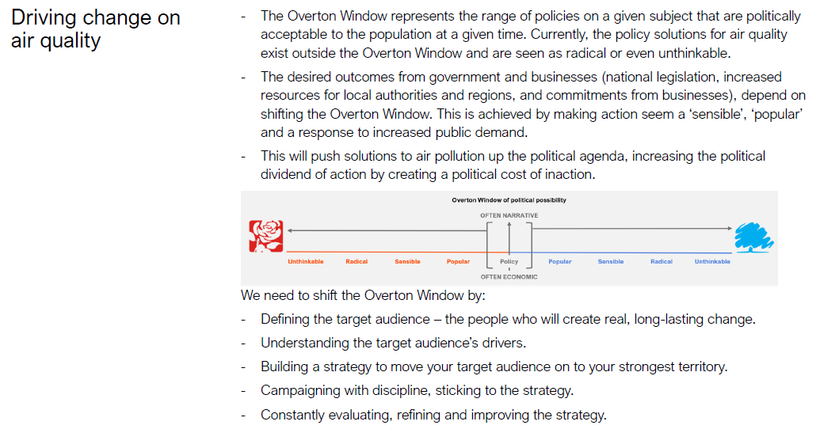

Slide 21
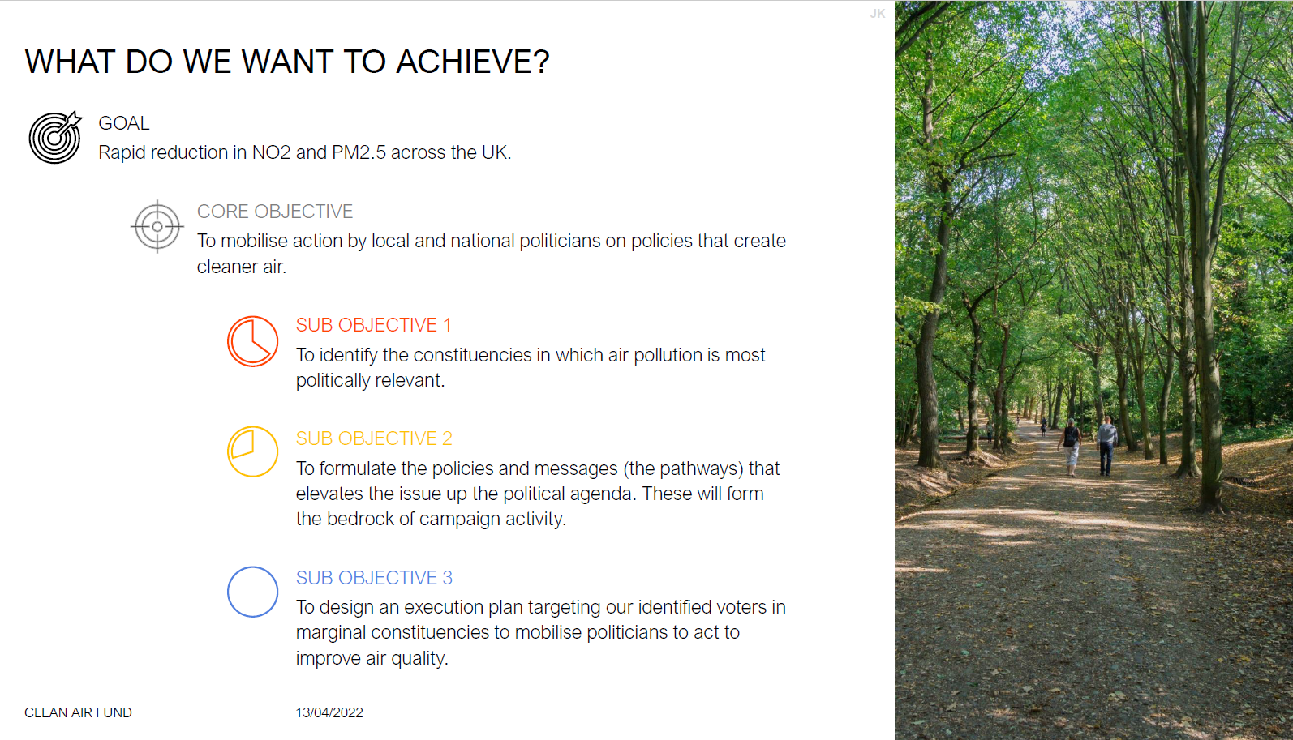

Slide 22
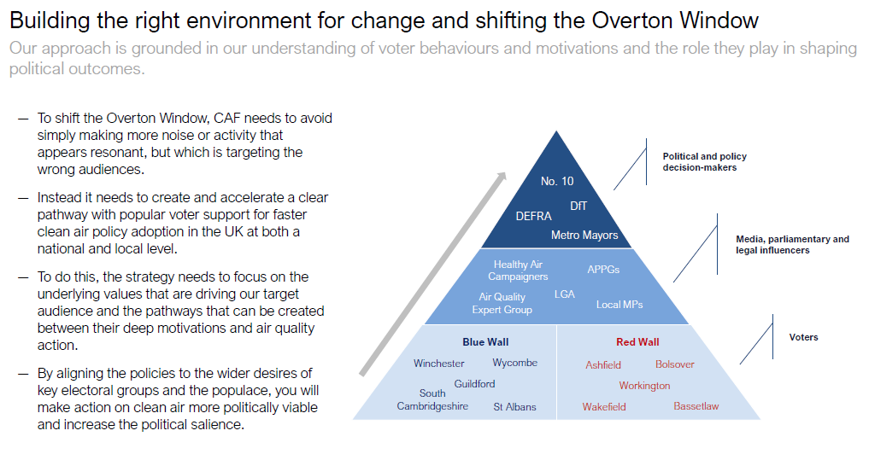

Slide 23
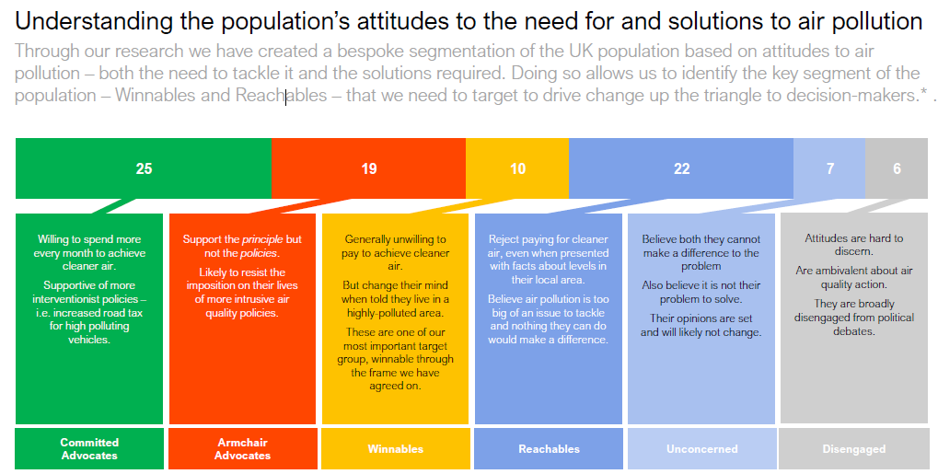

Slide 24
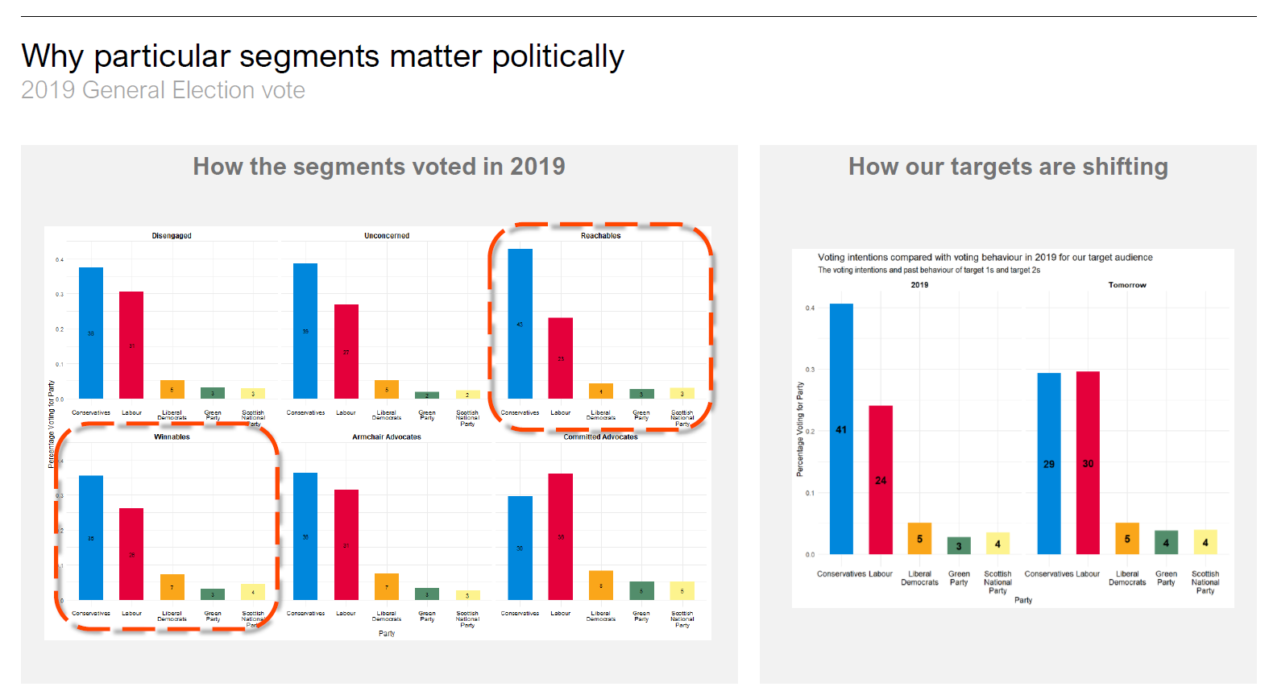

Slide 25
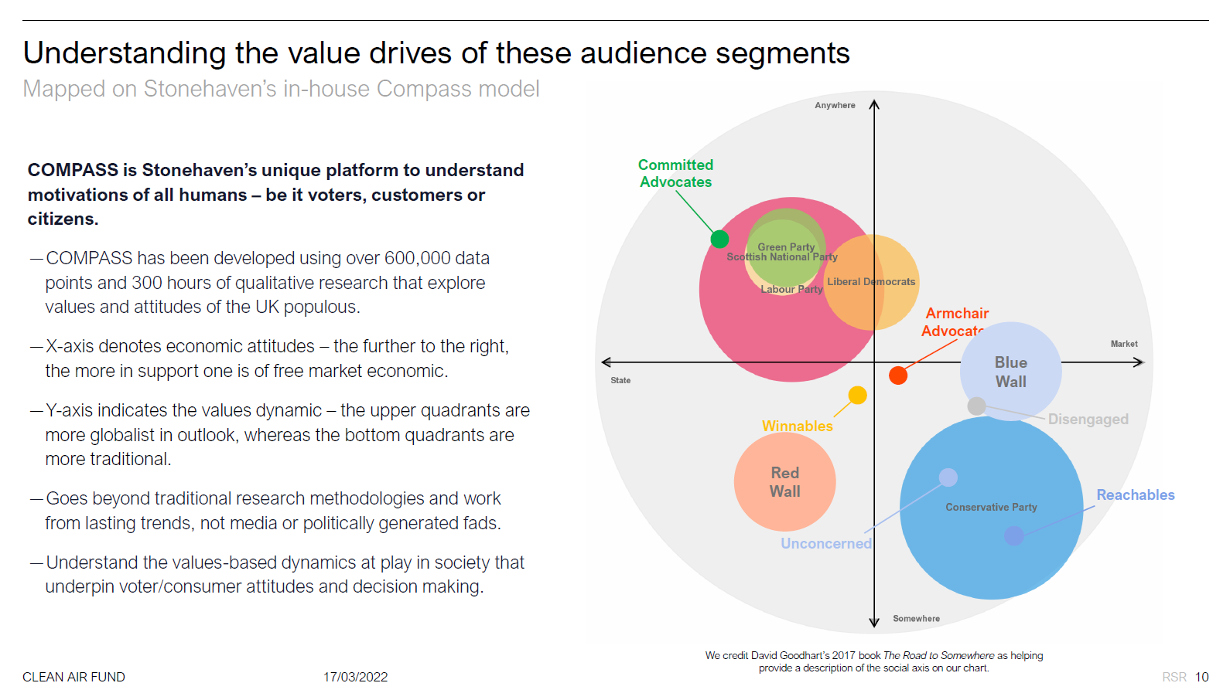

Slide 26
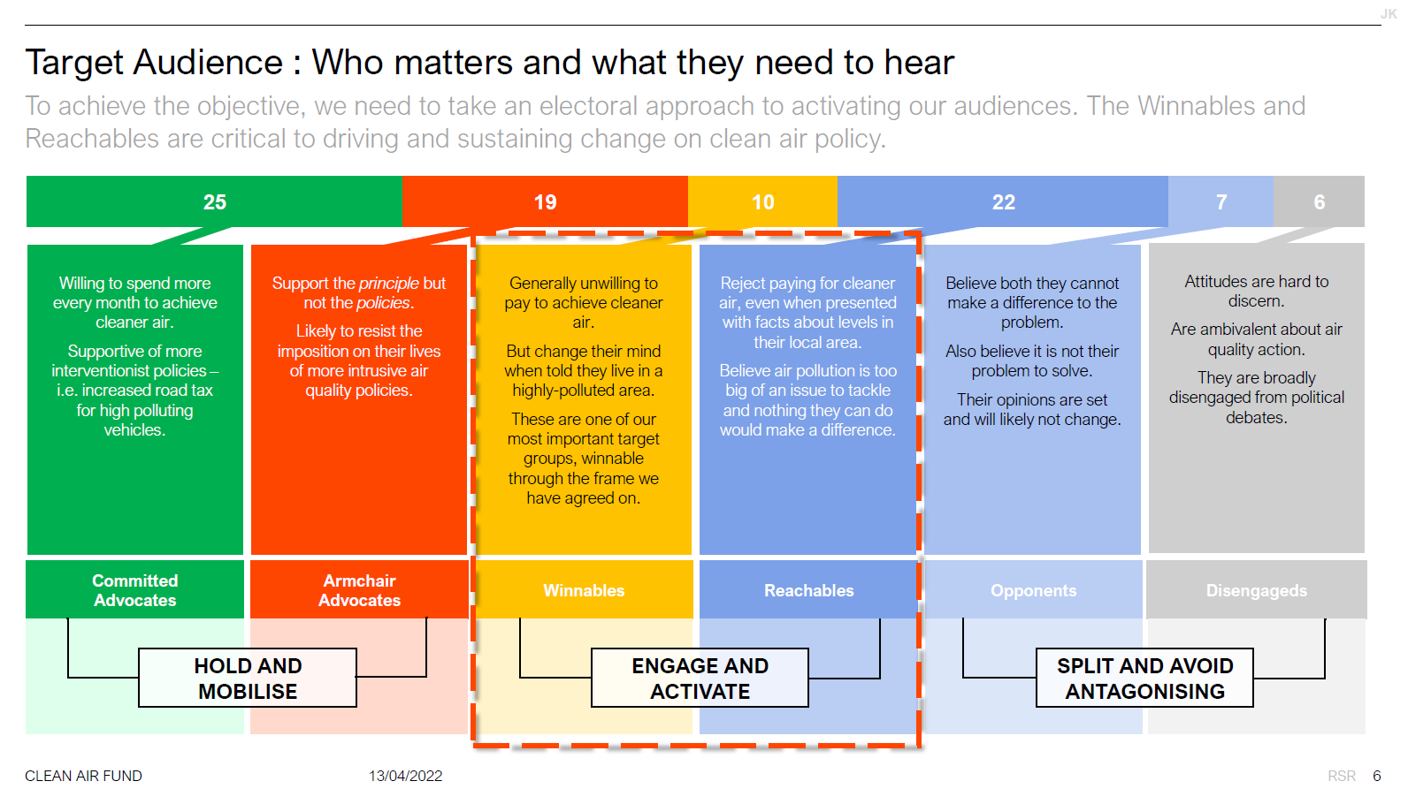

Slide 27
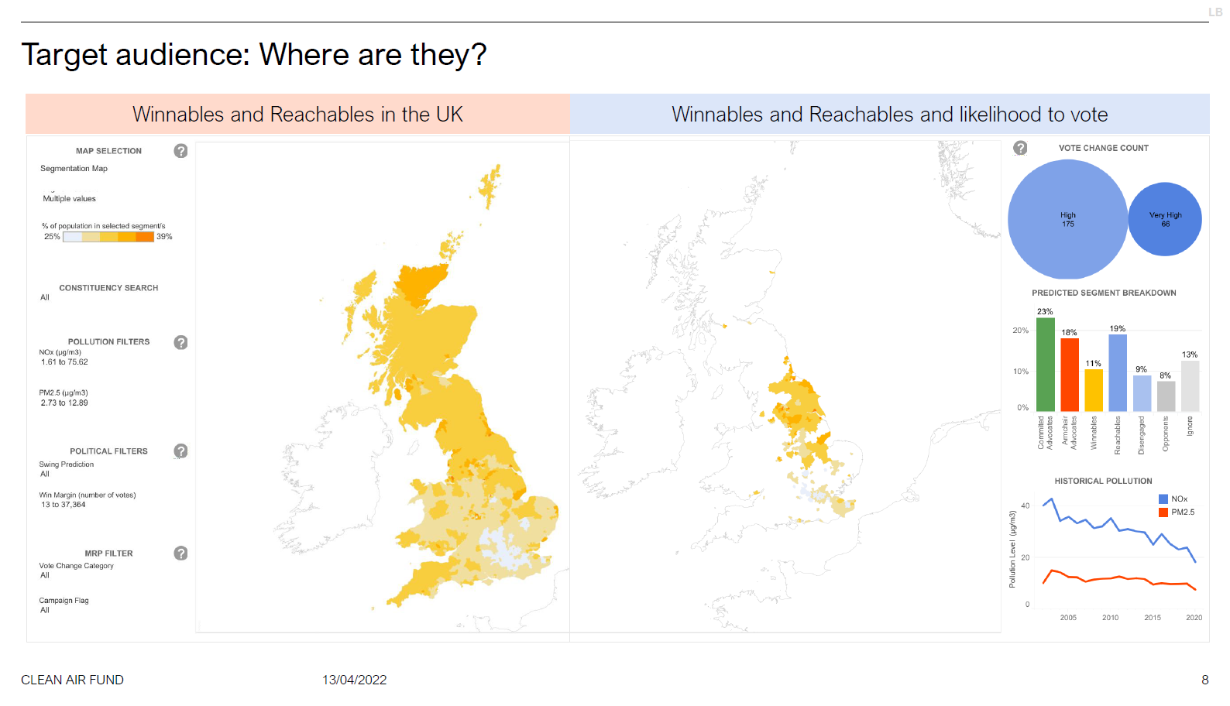
Notes:
election

Slide 28
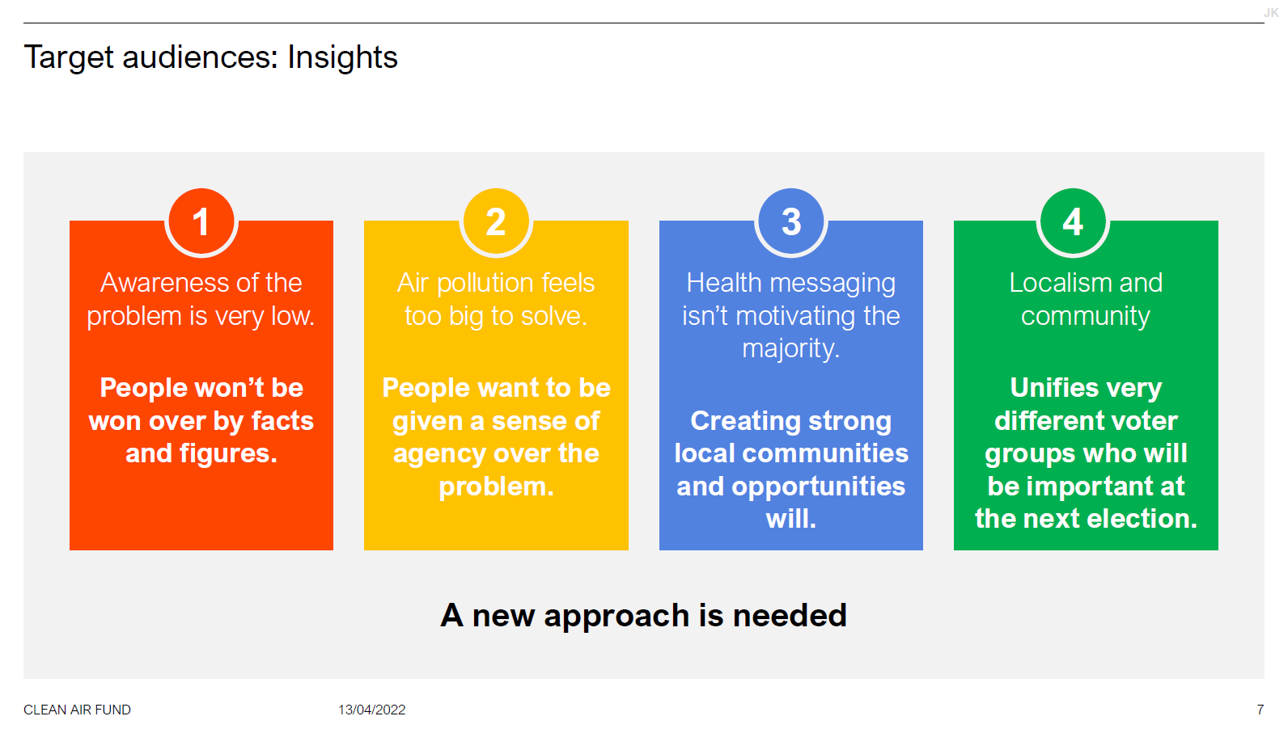
Notes:
reachables in target seats

Slide 29
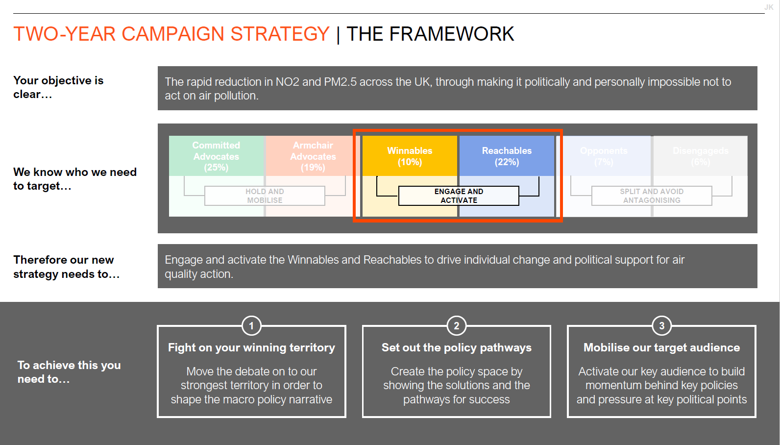

Slide 30
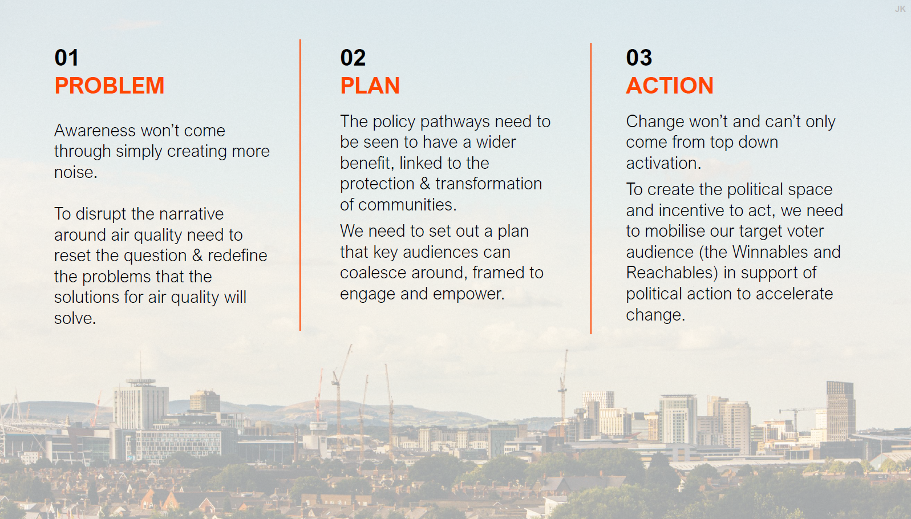

Slide 31
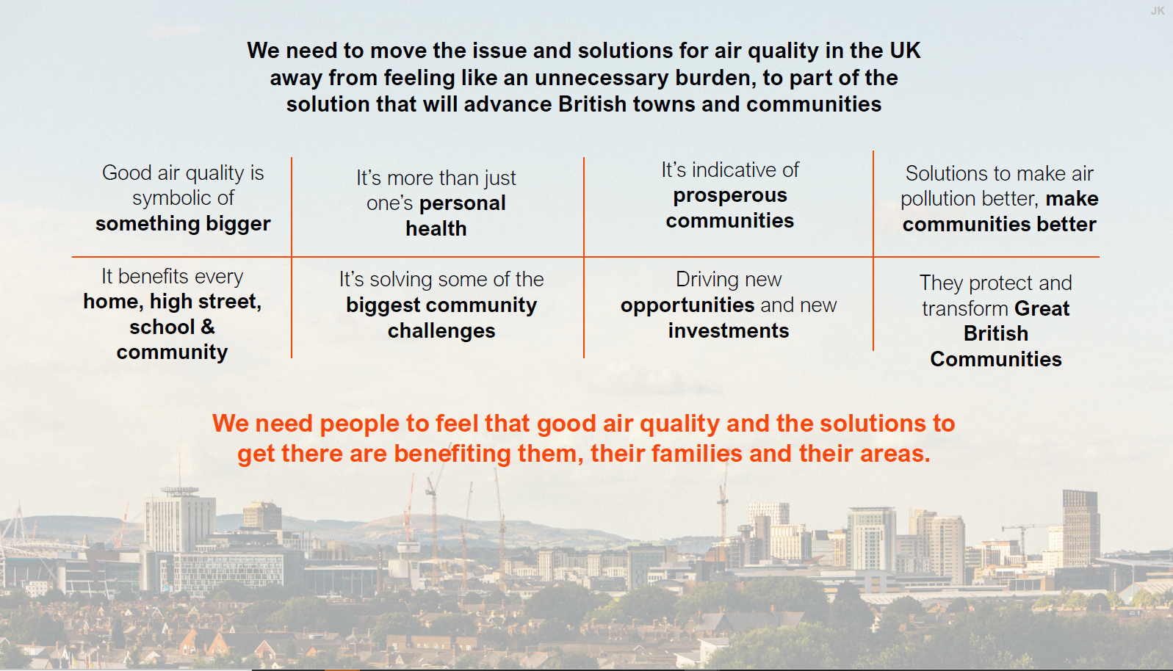

Slide 32
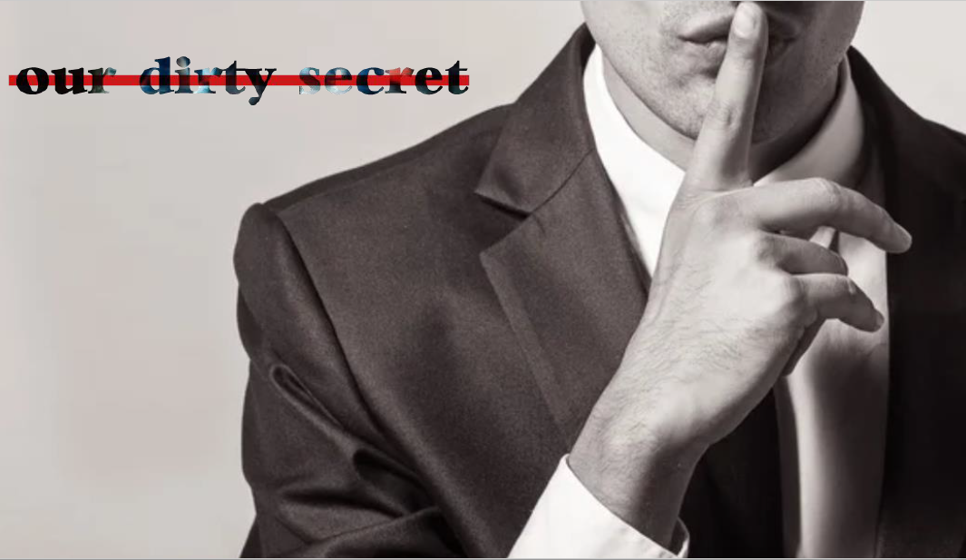

Slide 33

Our dirty secret manifesto
Elevator pitch: Our MPs, councillors and big businesses know our town’s dirty secret –our fume-filled air. We need to expose this dirty secret andstop the fumes. Government and big businesses need to come clean, give us a proper plan and finally deliver the investment our town needs.
Campaign narrative: Do you know our town’s dirty secret? A dirty secret the local MPs know. A dirty secret the local councillors know. A dirty secret big businesses know.A dirty secret they know but do nothing about.
The dirty secret is our town’s dirty fume-filled air.
It’s choking our high street, stopping proper local businesses from thrivinghere. It’s choking our community, forcing young people and families away.It’s choking all of us, stopping us from building a town we can be proud of. Our town can’t catch a break.
The plan is there, UK communities can get a clean break. But Government and big businesses need to act, and finally deliver the investment our town needs.They need to help usdrive cleaner cars, give us access to proper public transport andstop forgetting about us for once. They need to tell the truth, come clean and help usrevitalise our town.
Now you know their dirty secret, they can’t hide any longer. Demand they secure what our town needs to clean up our fume-filled air and make usproud to live here again or lose your hard-won vote. There’s no time for hot air.
Expose the dirty secret, stop the fumes and clean up this town.

Slide 34
40 Bermondsey Street London SE1 3UD
info@cleanairfund.org
www.cleanairfund.org
@cleanairfund

